Slide 1
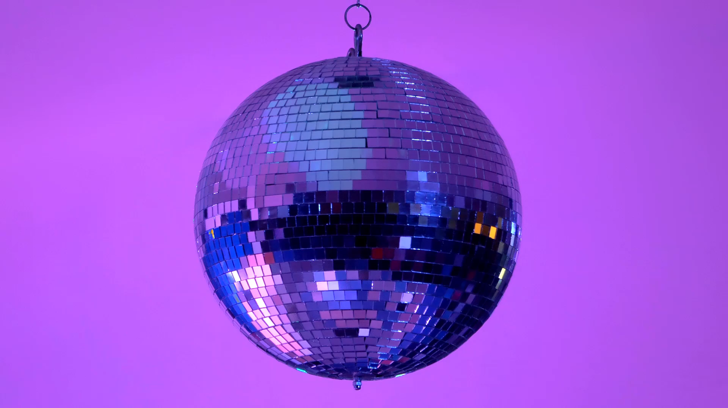
BLOCK AVERAGES EXTRAVAGANZA
A party for the people, by the people, and of the people

Slide 2
SRM-NIRS-EEG-1 WITH breath hold normalization
Most Recent Experiment

Slide 3
Speech Masker Only (8 trials/condition)

Slide 4
Noise Masker Only (8 trials/condition)

Slide 5
Both Maskers (16 trials/condition)

Slide 6
Speech vs. Noise (64 trials/condition)

Slide 7
SRM-NIRS-EEG-1 WITHOUT breath hold norm
Most Recent Experiment

Slide 8
Speech Masker Only (8 trials/condition)

Slide 9
Noise Masker Only (8 trials/condition)

Slide 10
Both Maskers (16 trials/condition)

Slide 11
Speech vs Noise

Slide 13
OLD EXPERIMENT

Slide 14
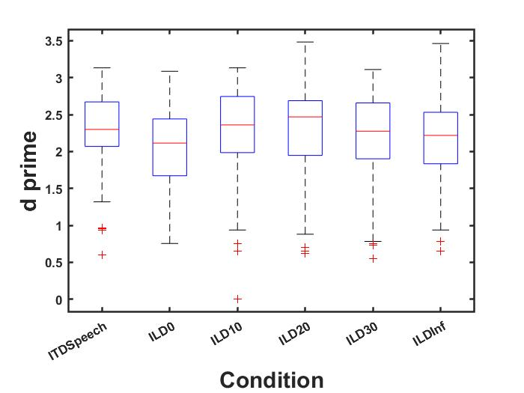
Conditions
- 500 us ITD (ITDSpeech)
- Co-located (ILD0)
- 10 dB ILD (ILD10)
- 20 dB ILD (ILD20)
- 30 dB ILD (ILD30)
- Infinite ILD (ILDInf, target in left masker in right)
** NO switch attend in this dataset

Slide 15
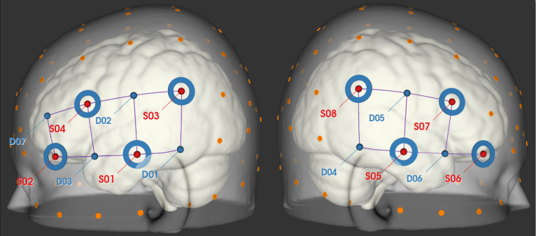
Montage

Slide 16
Old Experiment WITH Breath Hold

